Slide 1

Student Management System

Slide 2
Introduction
A student management system is an application that is designed to track, maintain and manage all the data generated by a School, including the grades of a student
It’s main function to maintain a proper database of its students to keep all the updated records and easily share information with students.

Slide 3


The Architecture of Angular,Spring & Database(MYSQL)
HTTP
Client
Components
Services
Spring
Rest
Controller
Spring
Data JPA
MYSQL
View
Templates

Slide 4
Angular 7
Typescript
Node JS
Frontend-side
Tools and
Technologies
VS Code IDE
Angular CLI
Bootstrap 4+

Slide 5
Angular 7
Angular 7
Typescript
Typescript
Node JS
Node JS
Frontend-side
Tools and
Technologies
VS Code IDE
VS Code IDE
Angular CLI
Angular CLI
Bootstrap 4+
Bootstrap 4+

Slide 6
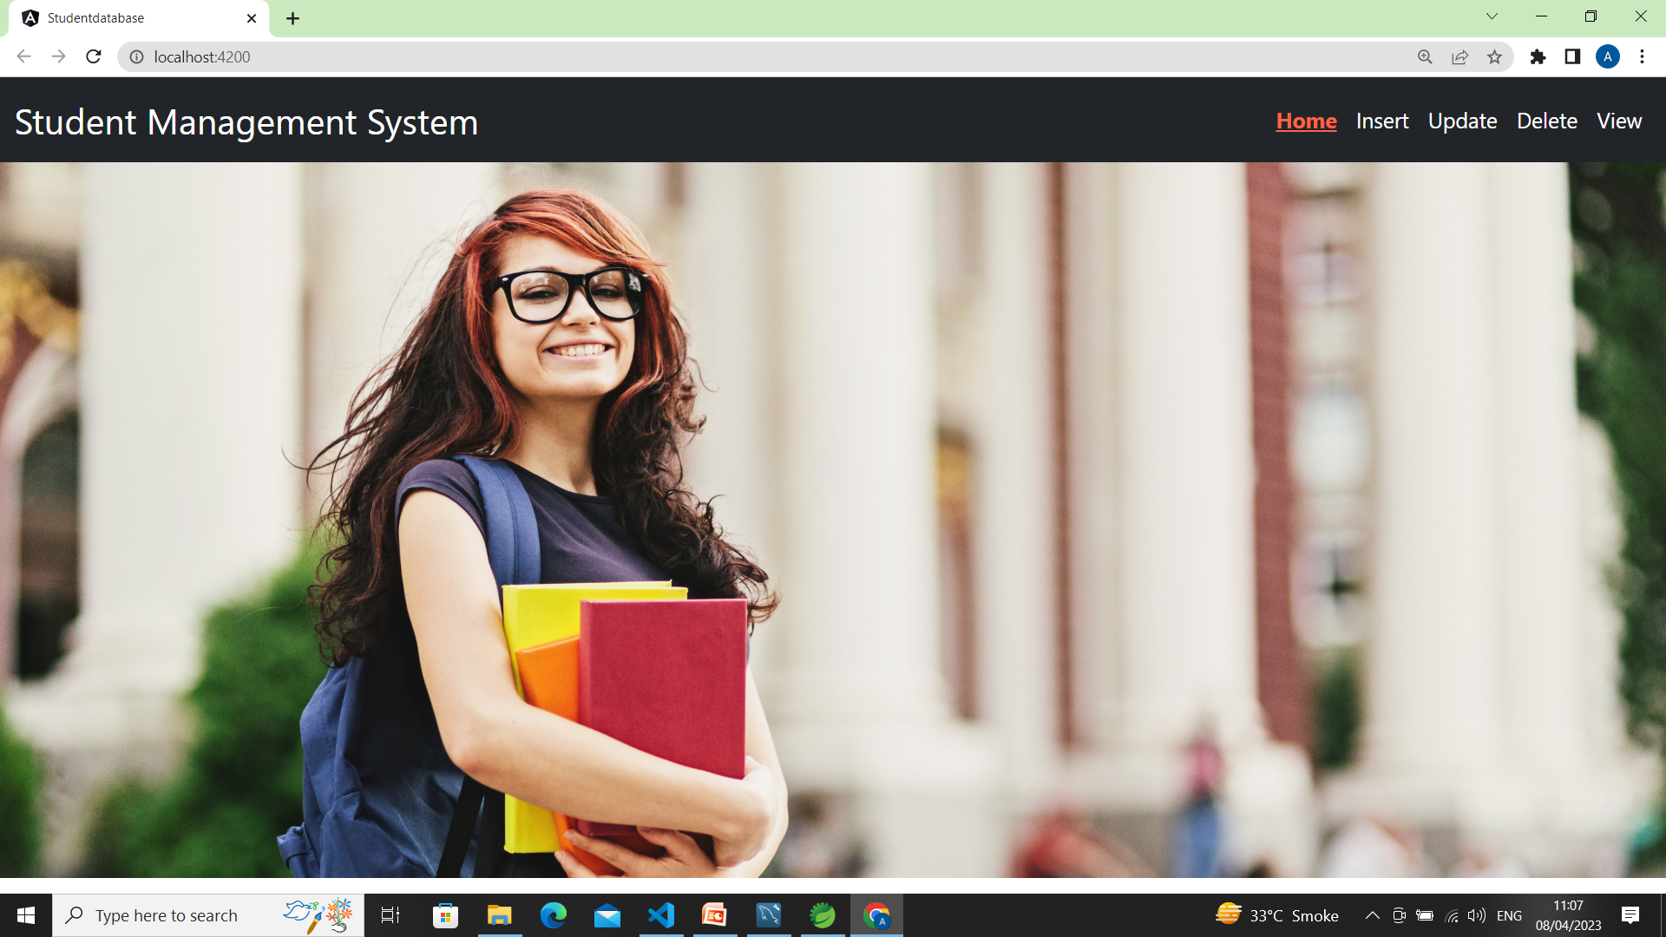
Home Page

Slide 7
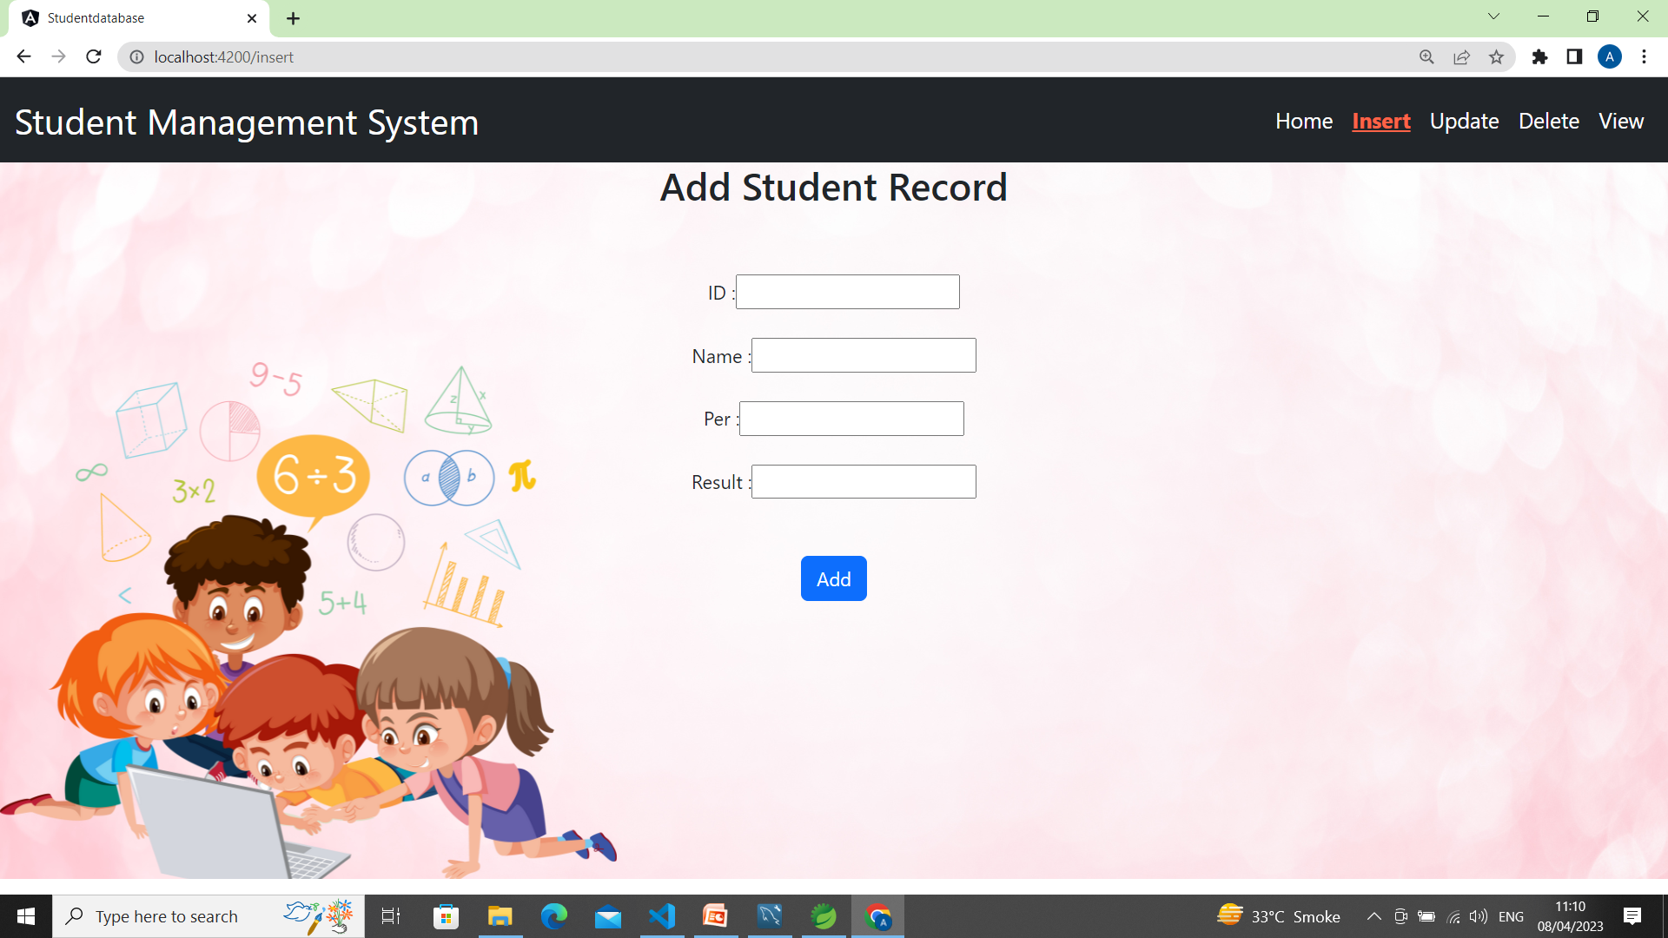
Add Page

Slide 8
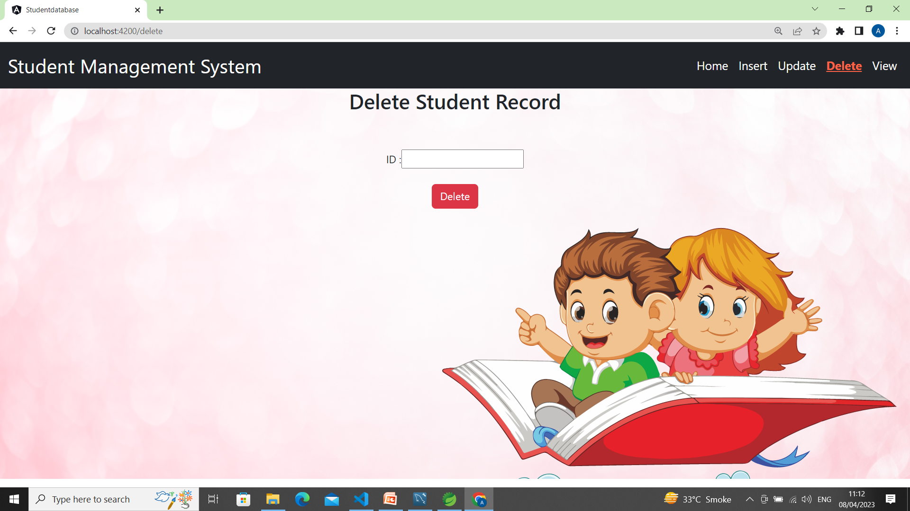
Delete Page

Slide 9
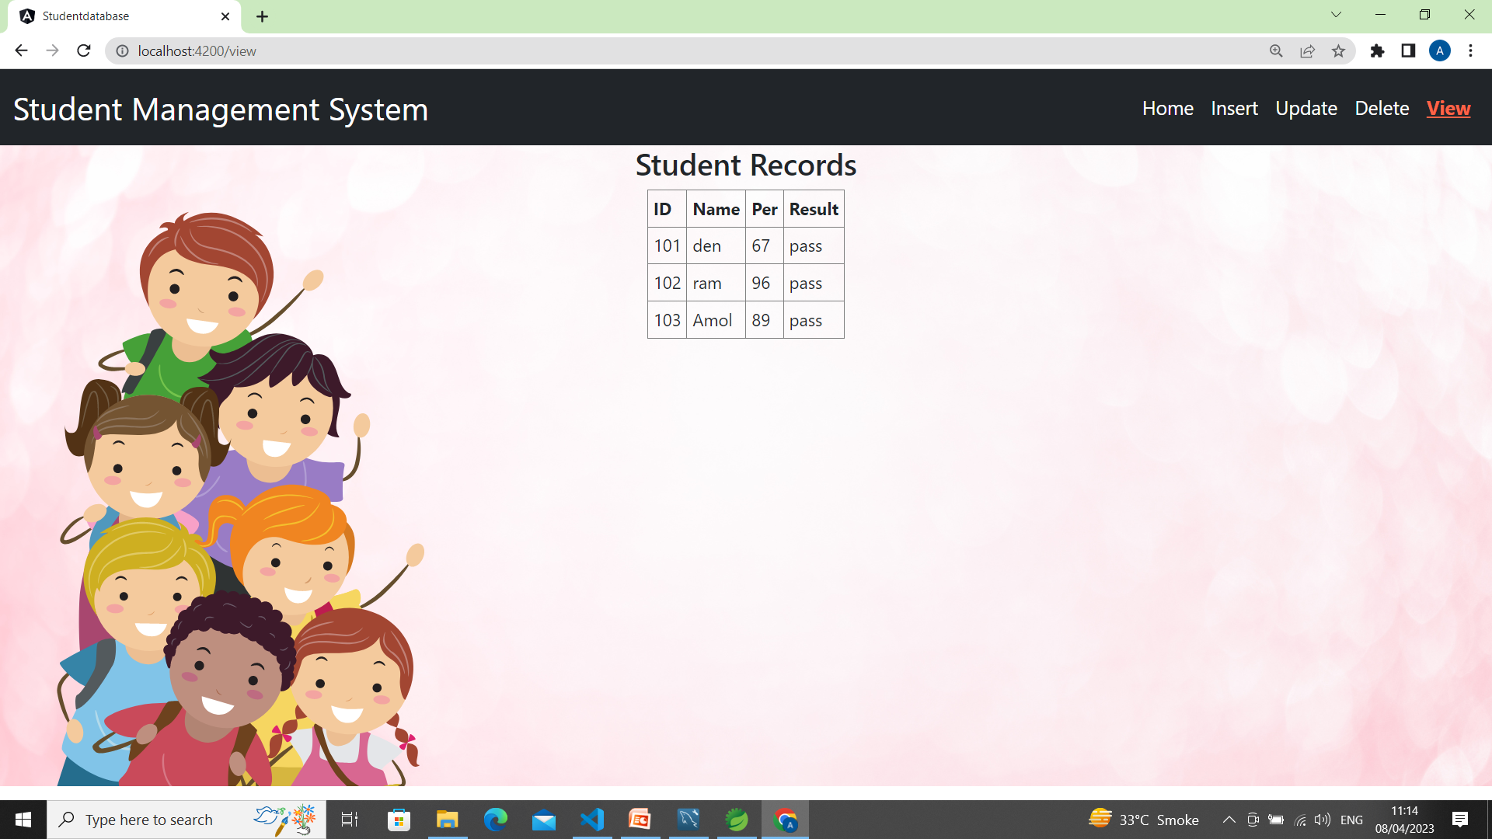
View Page

Slide 10
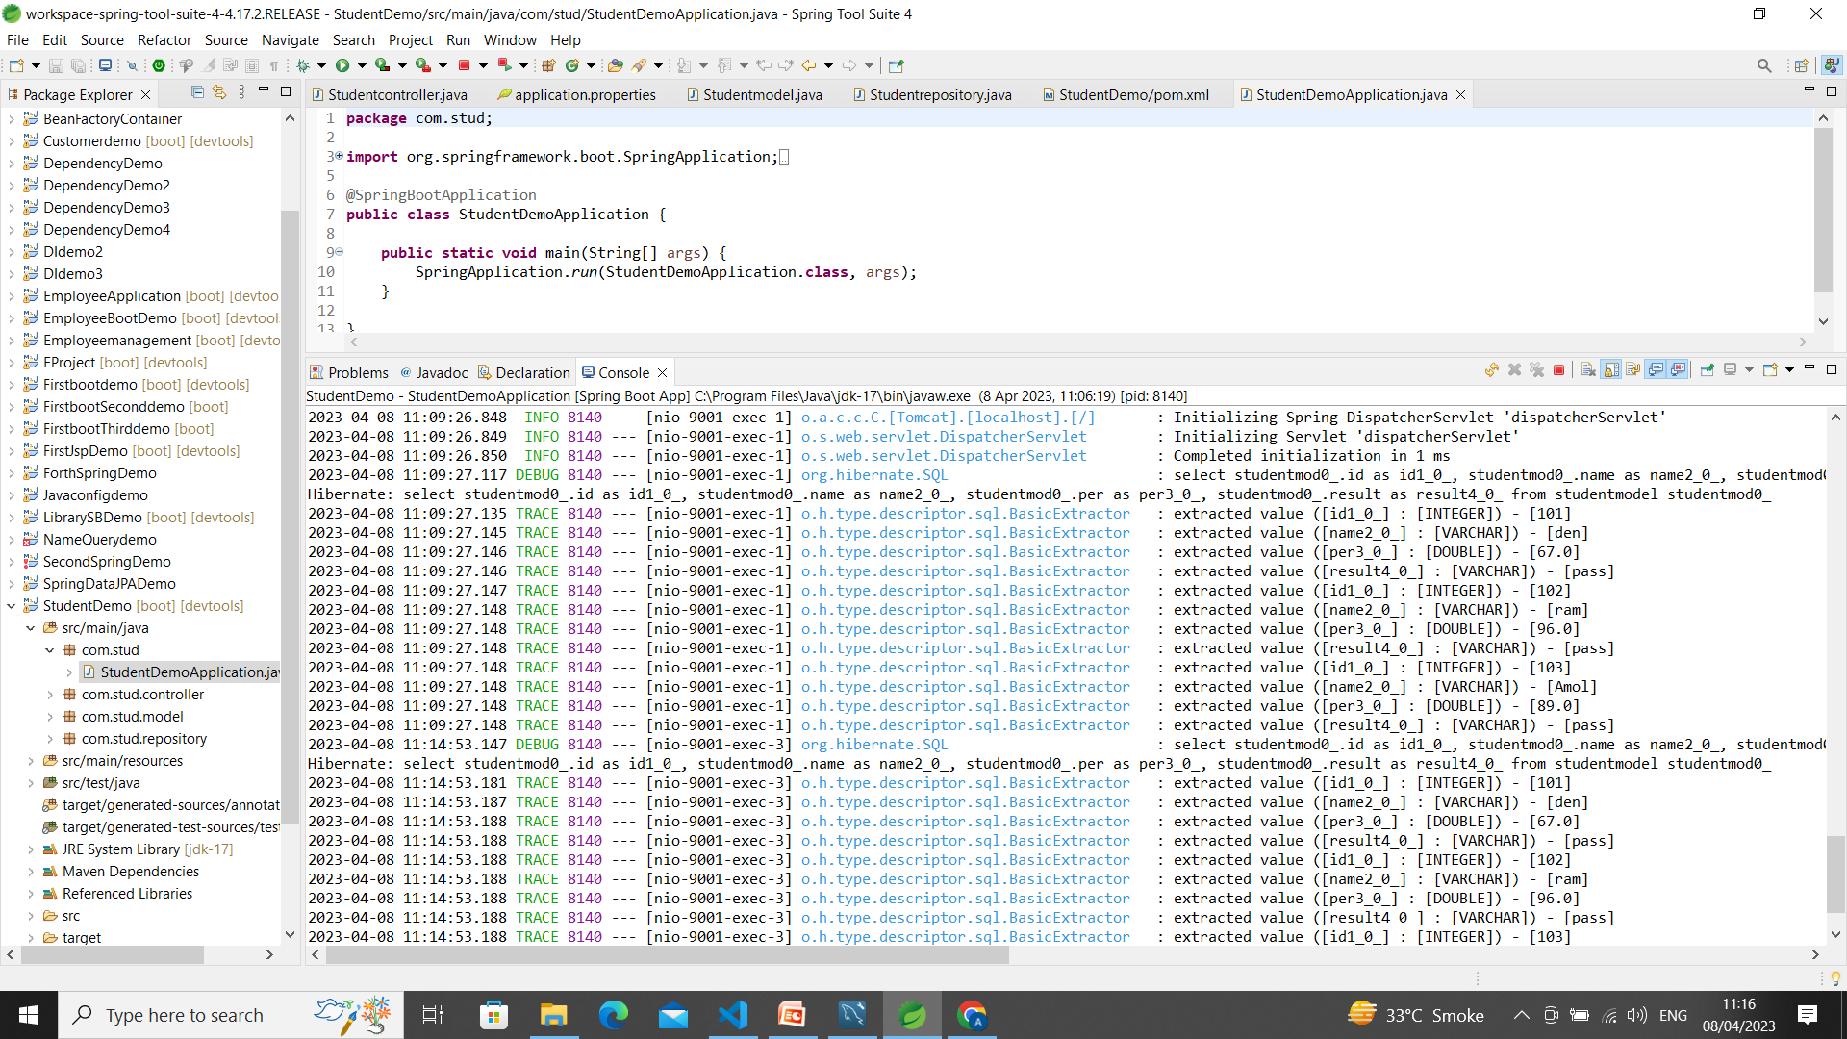
Spring Boot Application

Slide 11
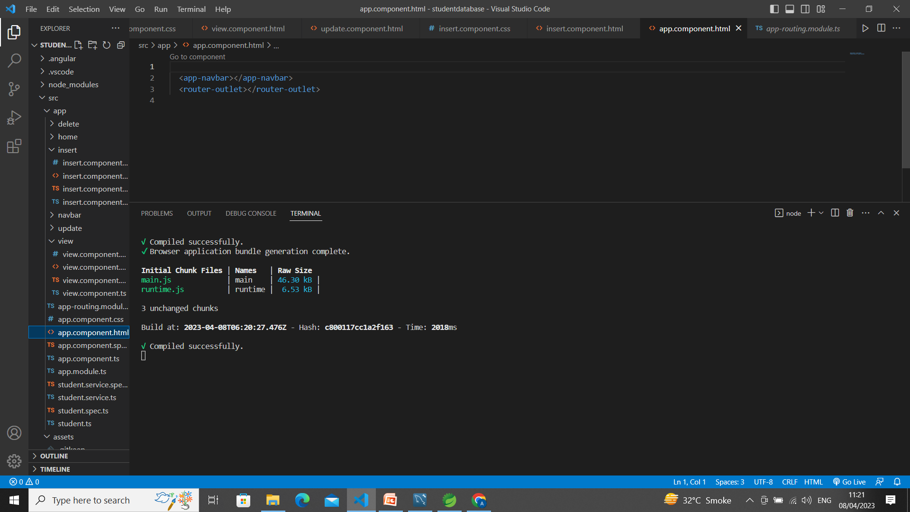
Frontend- Angular 7

Slide 12
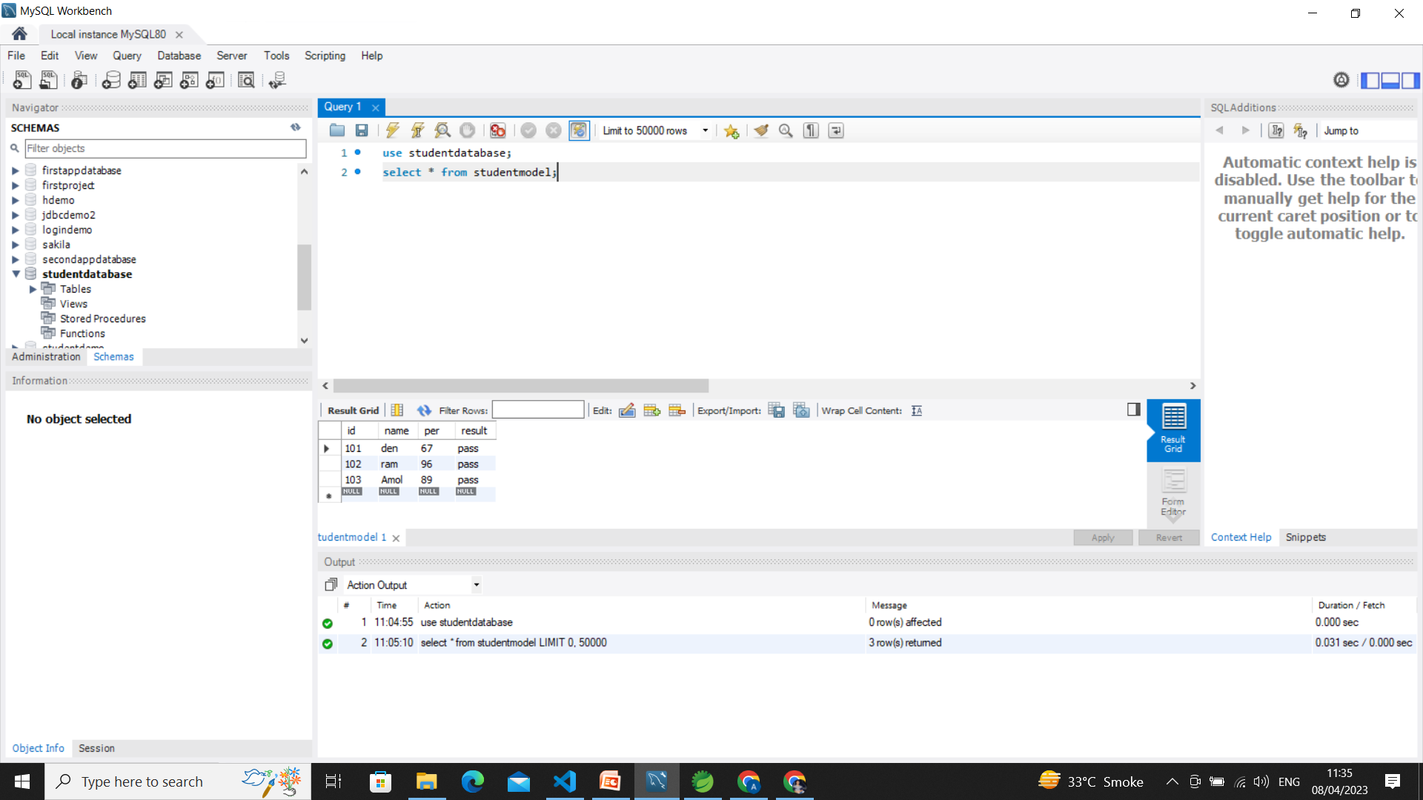
Database-MYSQL

Slide 13

We can add many feature like the students can also be able to upload & downloads notes.
We can add attendence of the students.
Also, it would be possible for students to watch lectures in the form of video content which would facilitate easy access to study material

Slide 14

Github Link
https://github.com/ankita12Shinde/Demo.git

